Slide 1
Introduction of Exception
By Lecturer Suraj Pandey CCT College

Slide 2
What is Exception
Exception are just runtime errors, the terms exception handling and error handling have becomes interchangeable. Exceptions occur when running a program is running. We can trap such exception and recover from them, rather than letting them bring your program to an inglorious end.
By Lecturer Suraj Pandey CCT College

Slide 3
An exception is a problem that arises during the execution of a program. An exception is a response to an exceptional circumstance that arises while a program is running, such as an attempt to divide by zero.
Exceptions provide a way to transfer control from one part of a program to another. VB.Net exception handling is built upon four keywords: Try, Catch, Finally and Throw.
By Lecturer Suraj Pandey CCT College

Slide 4
Exception Classes in .Net Framework
In the .Net Framework, exceptions are represented by classes. The exception classes in .Net Framework are mainly directly or indirectly derived from the System.Exception class. Some of the exception classes derived from the System.Exception class are the System.ApplicationException and System.SystemException classes.
The System.ApplicationException class supports exceptions generated by application programs. So the exceptions defined by the programmers should derive from this class.
The System.SystemException class is the base class for all predefined system exception.
By Lecturer Suraj Pandey CCT College

Slide 5
The following table provides some of the predefined exception classes derived from the Sytem.SystemException class:
By Lecturer Suraj Pandey CCT College

Slide 6
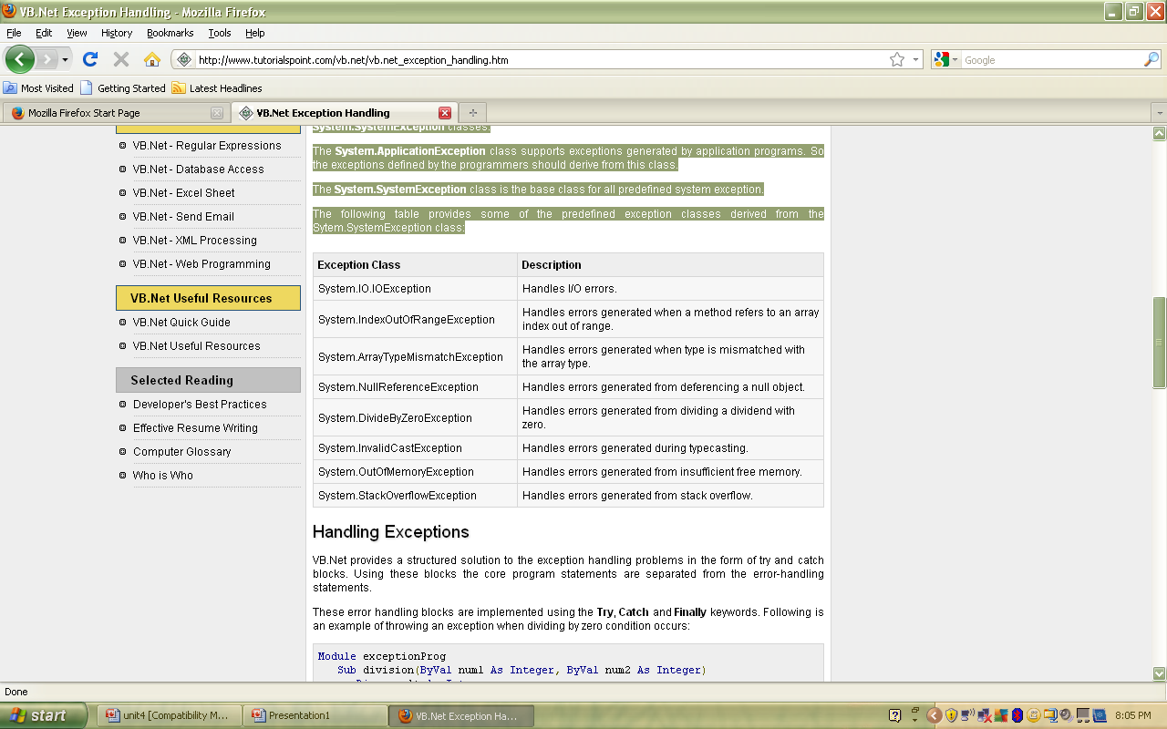
By Lecturer Suraj Pandey CCT College

Slide 7
Types of Exception handling
Unstructured Exception handling
Structured Exception handling
By Lecturer Suraj Pandey CCT College

Slide 8
Structured Exception Handling
Structured exception handling tests specific pieces of the code and, as exceptions occur, adapts your exception-handling code to the circumstances that caused the exception. It is significantly faster in large applications than unstructured exception handling and allows more flexible response to errors as well as greater application reliability.
The Try...Catch...Finally control structure is fundamental to structured exception handling. It tests a piece of code, filters exceptions created by the execution of that code, and reacts differently based on the type of thrown exception.
By Lecturer Suraj Pandey CCT College

Slide 9
The Try...Catch...Finally block
Try...Catch...Finally control structures test a piece of code and direct how the application should handle various categories of error. Each of the structure's three constituent parts plays a specific role in this process.
By Lecturer Suraj Pandey CCT College

Slide 10
Try: A Try block identifies a block of code for which particular exceptions will be activated. It's followed by one or more Catch blocks.
Catch: A program catches an exception with an exception handler at the place in a program where you want to handle the problem. The Catch keyword indicates the catching of an exception.
Finally: The Finally block is used to execute a given set of statements, whether an exception is thrown or not thrown. For example, if you open a file, it must be closed whether an exception is raised or not.
By Lecturer Suraj Pandey CCT College

Slide 11
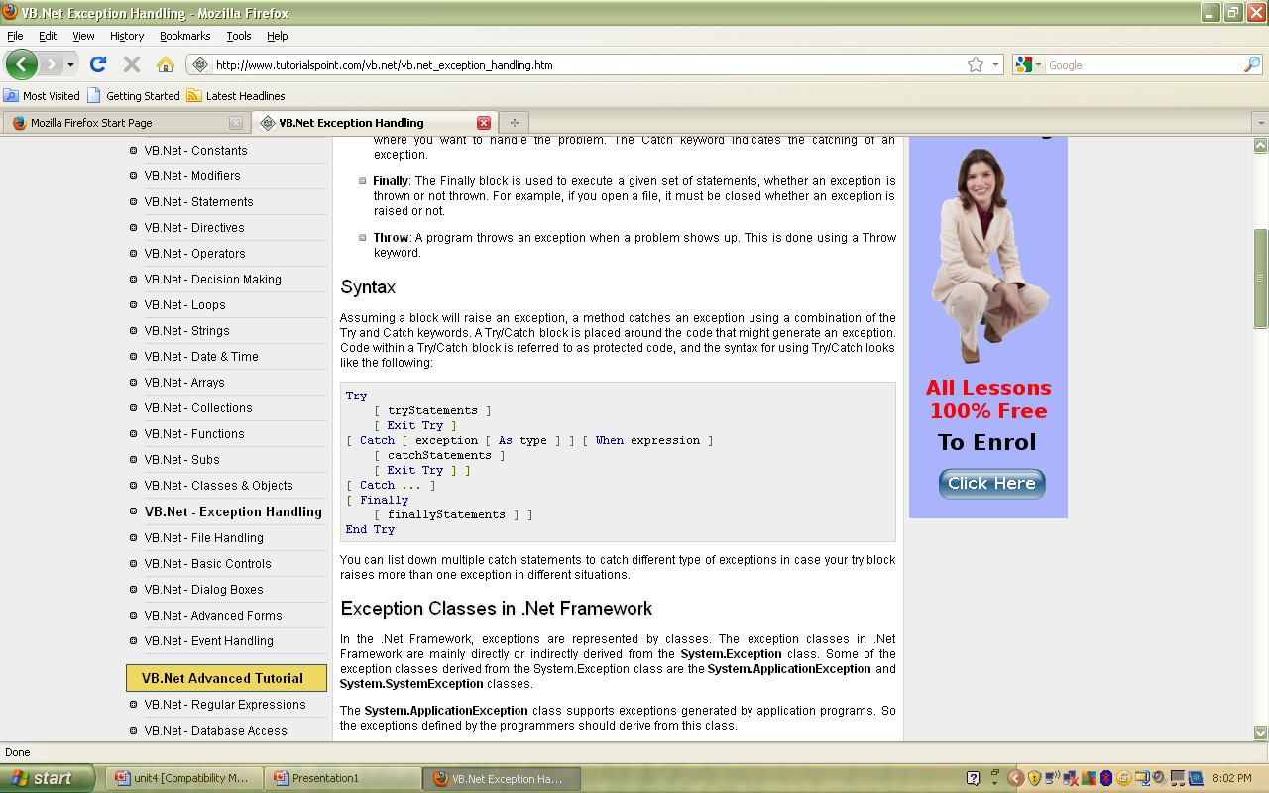
By Lecturer Suraj Pandey CCT College

Slide 12
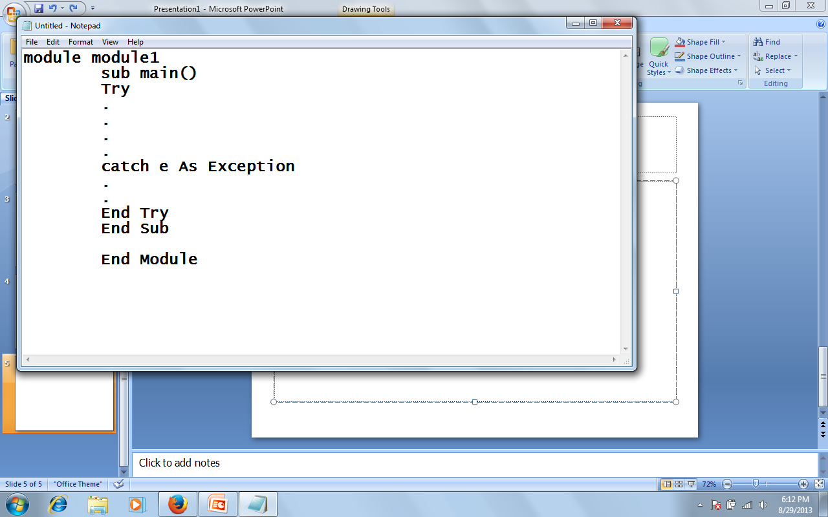
By Lecturer Suraj Pandey CCT College

Slide 13
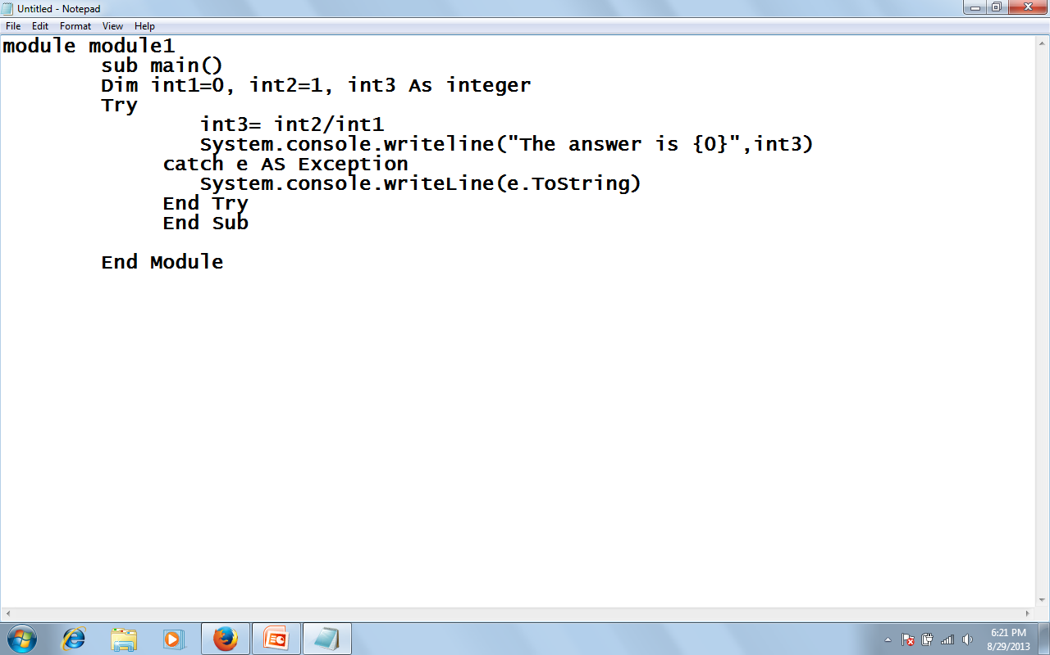
By Lecturer Suraj Pandey CCT College

Slide 14
Unstructured Exception Handling
Unstructured exception handling is implemented using the Err object and three statements: On Error, Resume, and Error.
The On Error statement establishes a single exception handler that catches all thrown exceptions. The method keeps track of the most recently thrown exception as well as the most recent exception-handler location.
By Lecturer Suraj Pandey CCT College

Slide 15
Example:
Module Module1
Sub function1()
Dim a, b, c As Integer
Console.WriteLine("Enter value for a:")
a = Console.ReadLine()
Console.WriteLine("Enter value for b:")
b = Console.ReadLine()
On Error GoTo Errorhandler
c = a / b
Console.WriteLine("Result: {0}", c)
Exit Sub
Errorhandler:
Console.WriteLine("You got an error")
End Sub
Sub Main()
function1()
Console.ReadKey()
End Sub
End Module
Lecturer: Suraj Pandey CCT College

Slide 16
b. On Error Resume Next:
The On Error Resume Next statement specifies that in the event of a run-time error control passes to the statement immediately following the one in which the error occurred. At that point, execution continues. On Error Resume Next enables us to put error-handling routines where errors will occur, rather than transferring control to another location in the procedure. Another variation on the
Resume statement is Resume Line, which is similar to On Error GoTo Line. Resume Line passes control to a line we specify in the line argument. We can use Resume Line only within an error handler
Lecturer: Suraj Pandey CCT College

Slide 17
Example:
Module Module1
Sub Main()
Dim a, b, c As Integer
Console.WriteLine("Enter value for a:")
a = Console.ReadLine() Console.WriteLine("Enter value for b:")
b = Console.ReadLine()
On Error GoTo Errorhandler
c = a / b
Console.WriteLine("Result: {0}", c) Console.ReadKey()
Exit Sub
Errorhandler:
Console.WriteLine("You got an error")
Resume Next
End Sub
End Module
Lecturer: Suraj Pandey CCT College

Slide 18
Resume
The Resume statement by itself can return control to the statement that caused the exception. The execution resumes at the same line that initially raised the exception.
By Lecturer Suraj Pandey CCT College

Slide 19
The Error Statement
The Error statement is supported in Visual Basic .NET only for backwards compatibility. In new code, use the Err object's Raise method to generate run-time errors.
By Lecturer Suraj Pandey CCT College

Slide 20
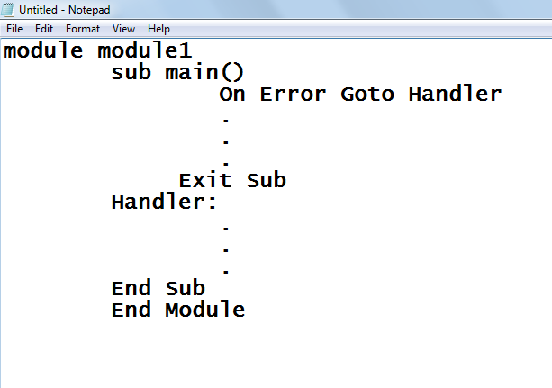
By Lecturer Suraj Pandey CCT College

Slide 21
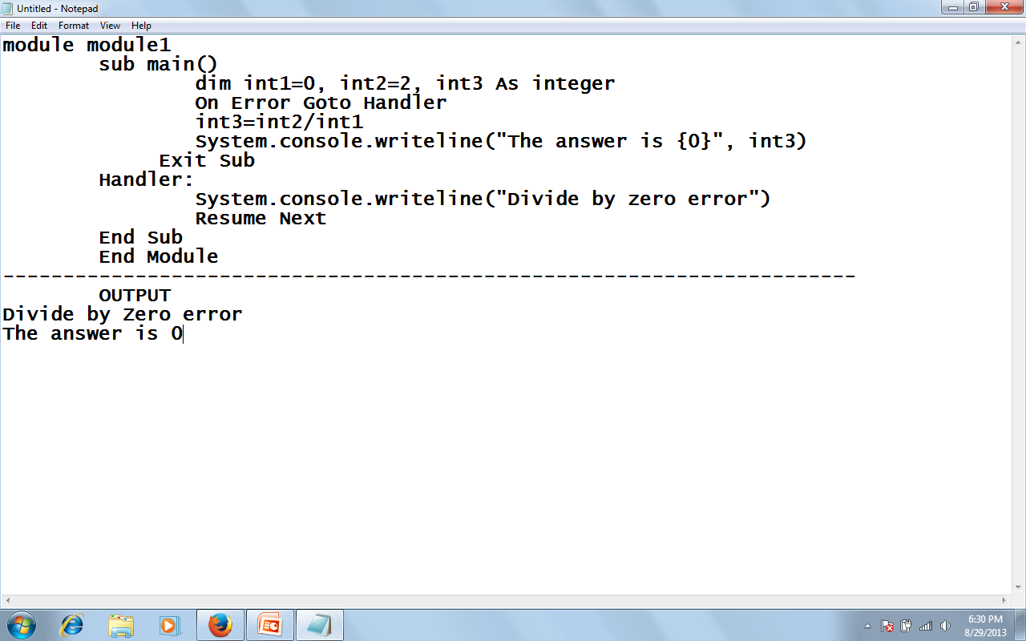
By Lecturer Suraj Pandey CCT College

Slide 22
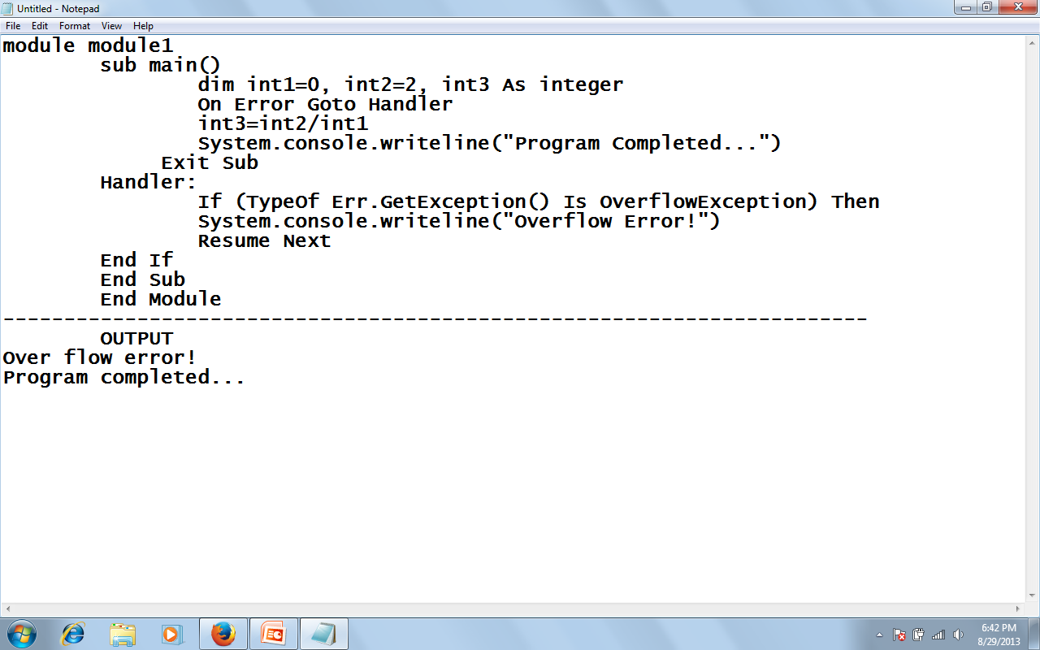
By Lecturer Suraj Pandey CCT College

Slide 23
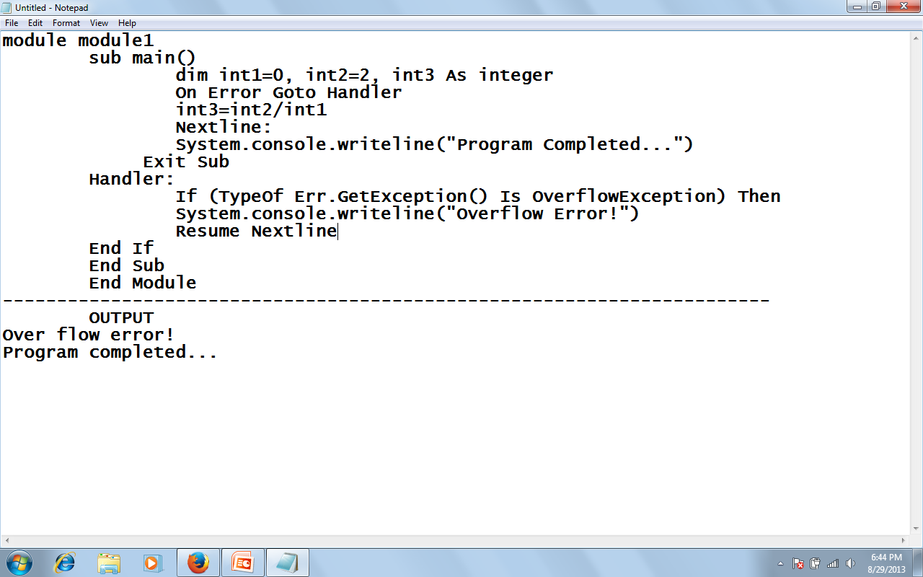
Example using Resume Line
By Lecturer Suraj Pandey CCT College

Slide 24
c. On Error GoTo 0:
The On Error GoTo 0 statement disables any error handler in the current procedure. If you do not include an On Error GoTo 0 statement, the error handler is still disabled when the procedure containing the exception handler ends.
d. On Error GoTo -1:
The On Error GoTo -1 statement disables any exception handlers in the current procedure. If you do not include an On Error GoTo -1 statement, the exception is automatically disabled when its procedure ends.
Lecturer: Suraj Pandey CCT College

Slide 25
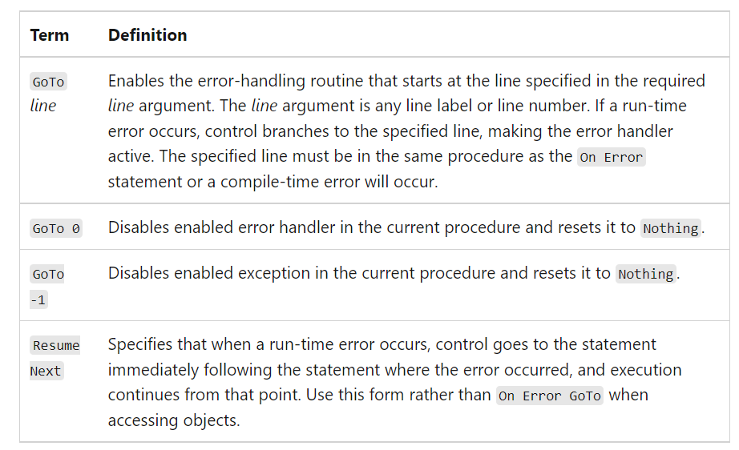
Lecturer: Suraj Pandey CCT College

Slide 26
Raising an Exception Intentionally
There are cases in programs where you might want to create an exception because, although no visual basic trappable exception has occurred, some situation may have occurred that’s incompatible with your program’s logic. You can create an exception intentionally raising an exception, with the visual basic Err object’s Raise method, which is declared this way internally in VB.NET:
Raise(ByVal Number As Integer, Optional ByVal Source As Object= Nothing, Optional ByVal Description As object= Nothing, optional ByVal HelpFile As object= Nothing Optional ByVal HelpContext As Object=Nothing)
By Lecturer Suraj Pandey CCT College

Slide 27
Here are the arguments for the Raise method:
Number --- Long integer that identifies the nature of the exception
Source --- String expression naming the object or application that generated the exception, use the form project.class
Description --- String expression describing the exception
Helpfile --- The path to the help file in which help on this exception can be found
Helpcontext --- A context ID identifying a topic within helpfile that provides help for the exception.
By Lecturer Suraj Pandey CCT College

Slide 28
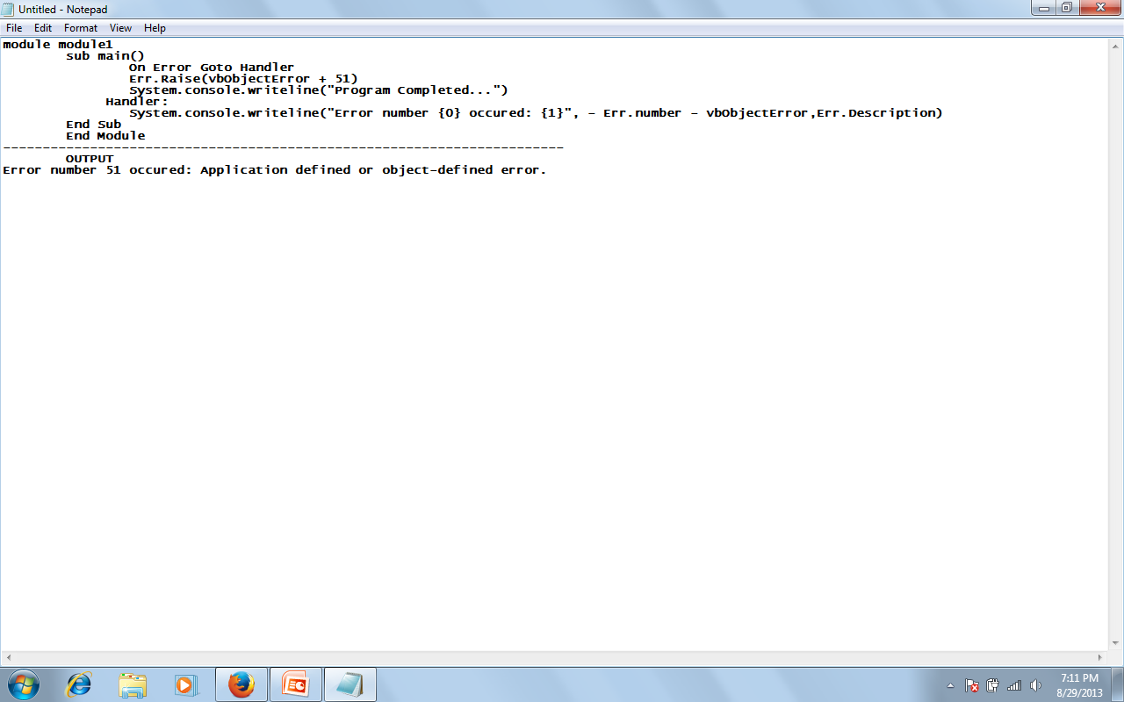
Example, here lets generate our own exception, exception number 51:
By Lecturer Suraj Pandey CCT College

Slide 29
Exception filtering in the catch block
When you’re handling exceptions you usually want to handle different types of exceptions differently, according to the nature of the exception that occurred. This process is called filtering.
There are actually two ways to filter exception with catch blocks. First you can filter on specific classes of exceptions, which means you have to prepare for the various exceptions you want to handle.
Exceptions are based on the visual basic exception class (which, like all other objects in visual basic, is based on the object class)
By Lecturer Suraj Pandey CCT College

Slide 30
To track down what class such an exception corresponds to, you could take a look at the visual basic documentation for the exception class, which lists the class derived from it:
System.Object System.ApplicationException
      System.IO.IsolatedStorage.IsolatedStorageException
      System.SystemException
      System.Windows.Forms.AxHost.InvalidActiveXStateException
By Lecturer Suraj Pandey CCT College

Slide 31
The derived class itself has many derived classes, the overflowException class, which is based on the ArithmeticException class, which is based on the SystemException class, which is based on the Exception class:
System.Object
System.Exception
System.SystemException
System.ArithmeticException
System.OverflowException
By Lecturer Suraj Pandey CCT College

Slide 32
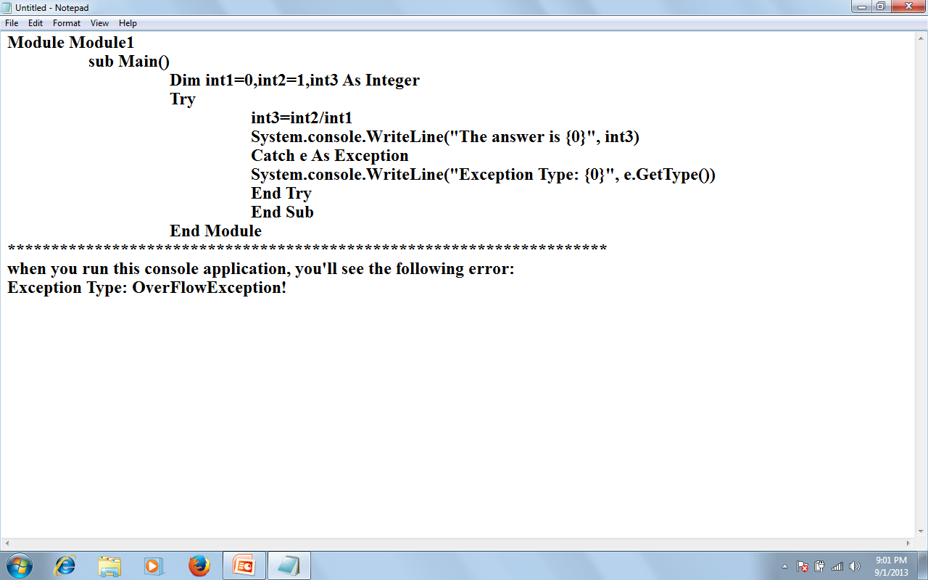
By Lecturer Suraj Pandey CCT College

Slide 33
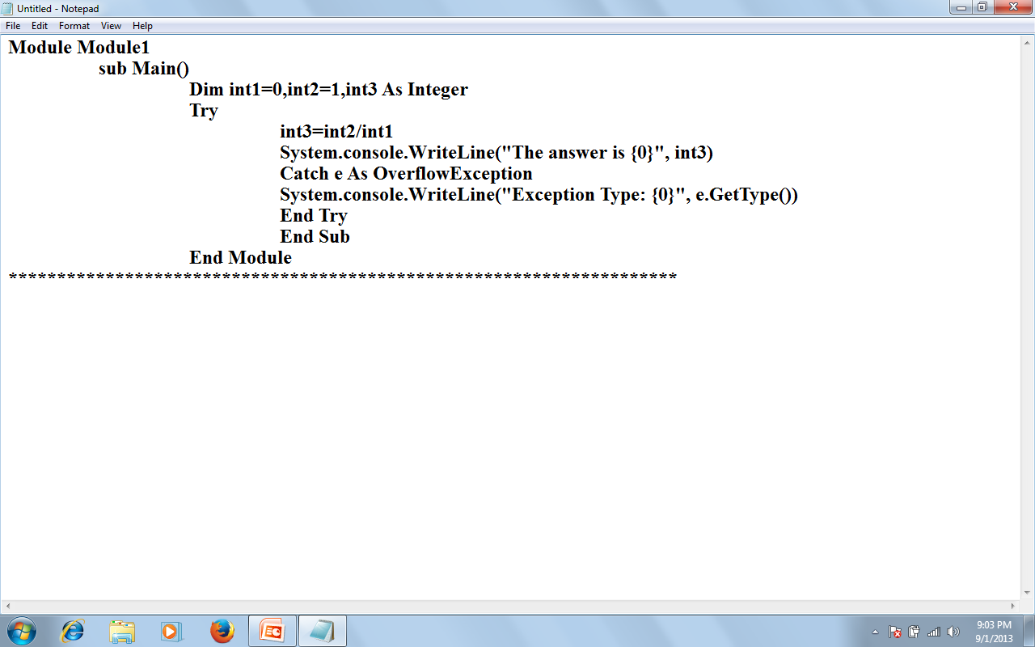
:Arithmetic overflow!”
By Lecturer Suraj Pandey CCT College

Slide 34
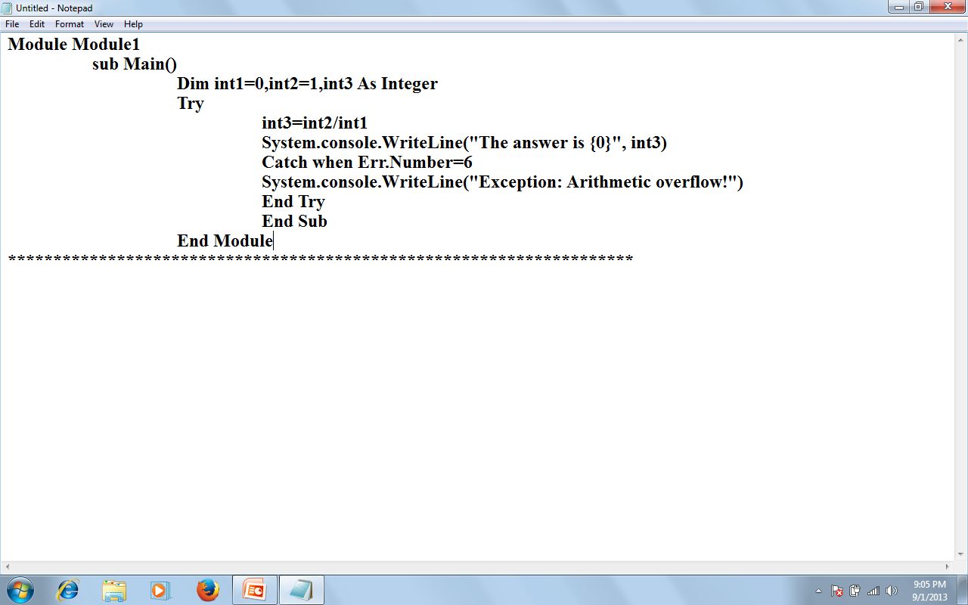
By Lecturer Suraj Pandey CCT College

Slide 35
USING MULTIPLE CATCH STATEMENTS
You also can use multiple catch statements when you filter exceptions. Here’s an example that specifically handles overflow, invalid argument, and argument out of range exceptions:
By Lecturer Suraj Pandey CCT College

Slide 36
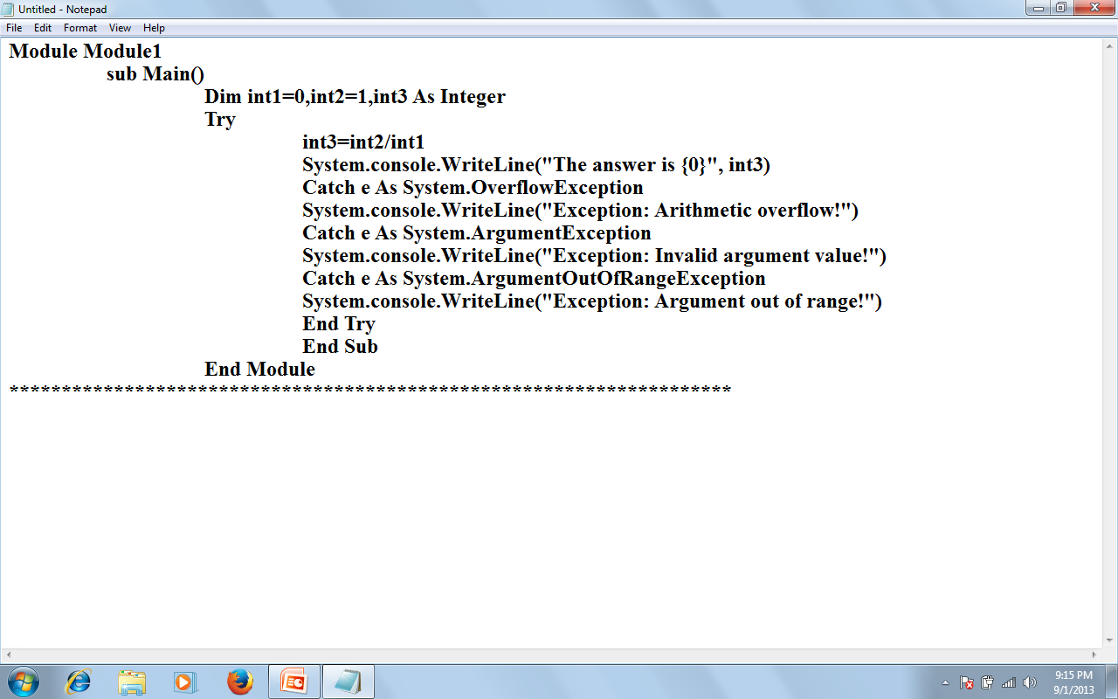
By Lecturer Suraj Pandey CCT College

Slide 37
If you want to add a general exception handler to catch any exceptions not filtered, you can add a catch block for the Exception class at the end of the other Catch blocks:
By Lecturer Suraj Pandey CCT College

Slide 38
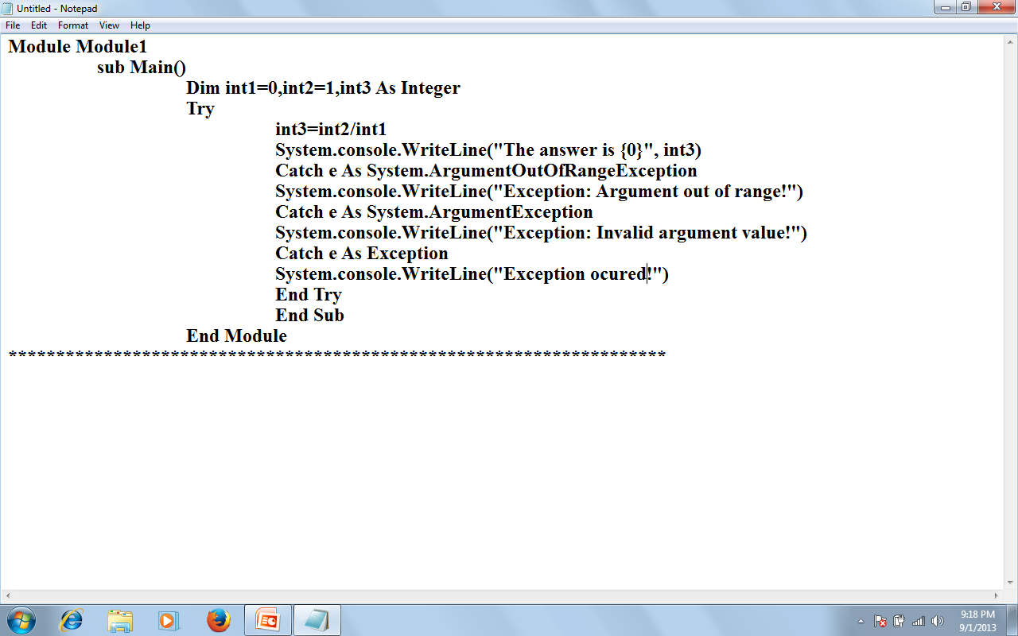
By Lecturer Suraj Pandey CCT College

Slide 39
Use Finally
The code in the Finally block, if there is one, is always executed in a Try…. Catch…..Finally statement, even if there was no exception, and even if you execute an Exit Try statement. This allows you to deallocate resources and so on. Here’s an example with a Finally block.
By Lecturer Suraj Pandey CCT College

Slide 40
Module Module1
Sub main()
Dim int1=0, int2=1, int3 As Integer
Try
int3=int2/int1
System.console.writeline(“The answer is {0}”, int3)
Catch e As System.OverflowException
System.console.WriteLine(“Exception: Arithmetic Overflow!”)
Catch e As System.ArgumentException
System.console.WriteLine(“Exception: Invalid argument value!”)
Catch e As System.ArgumentOutofRangeException
System.console.WriteLine(“Exception: Argument out of range!”)
Finally
System.console.WriteLine(“Execution of sensitive code” & “is complete” )
End Try
End Sub
End Module
By Lecturer Suraj Pandey CCT College

Slide 41
Exception: Arithmetic overflow!
Execution of sensitive code is complete
By Lecturer Suraj Pandey CCT College

Slide 42
Throwing an Exception
We can throw an exception using the Throw statement, and we can also rethrow a caught exception using the Throw statement. Here’s an example where we can explicitly throw an overflow exception:
Module Modul1
Sub Main()
Try
Throw New OverflowException()
Catch e As Exception
System.console.writeline(e.message)
End Try
End Sub
By Lecturer Suraj Pandey CCT College

Slide 43
Throwing a Custom Exception
We can customize the exception we throw by creating a new exception object based on the ApplicationException object. Here’s an example where we creating a new ApplicationException object with the text “This is a new exception”, and then throwing and catching that exception:
By Lecturer Suraj Pandey CCT College

Slide 44
Module Module1
Sub Main()
Try
Throw New ApplicationException(“This is a new exception”)
Catch e As Exception
System.console.WriteLine(e.Message)
End Try
End Sub
End Module
By Lecturer Suraj Pandey CCT College

Slide 45
This is a new exception
By Lecturer Suraj Pandey CCT College

